Slide 1
Observability
Security in the Age of AI
by David Pierce
Zeroday.tools
Latentspace.tools
Notes:
Hello my name is David and we're gonna talk about observability, specifically in the context of Securing AI systems

Slide 2
Agenda
Capabilities x Concerns
Concepts x Components
New Threats & New Vectors
Building Better Widgets
Managing Residual Risk
Looking at the Horizon
Appendix: System Hardening Checklist, Visualized Attacks, etc
Notes:
In practice, that means covering what they can do, how they work, and how they break. Additionally, we'll talk about cool new statistical methods for instrumenting these systems, how you manage risk at the appropriate rigor, etc.
Finally, we'll look at the future a little.

Slide 3

Capabilities & Concerns
Capabilities of Auto-Regressive Models
Operate Across Mediums & Channels
Capable of Task Planning & Orchestration
Self-Directed Downstream Agents & Systems
Concerns about AI Systems
Hallucinations & Auditability
Attack Strings & Abstracted Runtimes
(Im)Proper User Permissions
Notes:
To tell that story we have to back up just a little. This video is super cool but It's 9 months old and already out of date. That said, it show cases how these models allow for context switching in the real world, task planning, and self-directed goals.
The video alone is neat, but we have other stuff to important topics too; not just hallucinations, but actual vulnerabilities and improperly provisioned account integrations

Slide 4
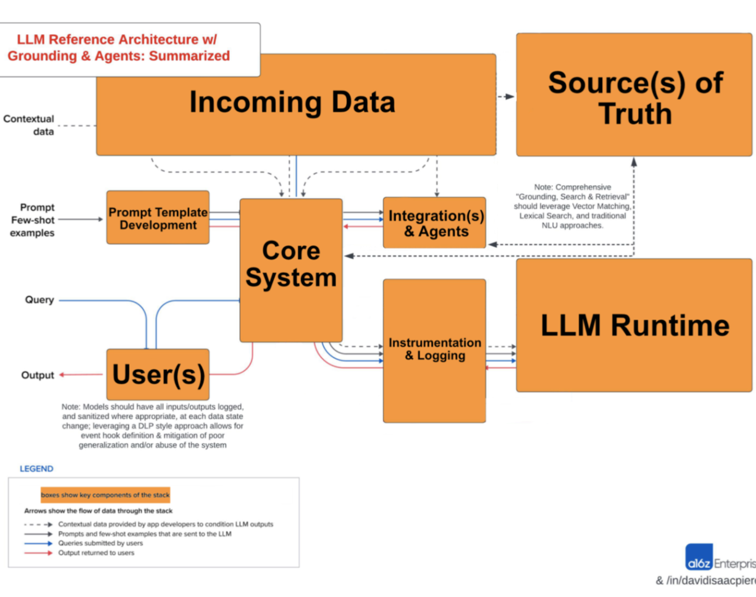
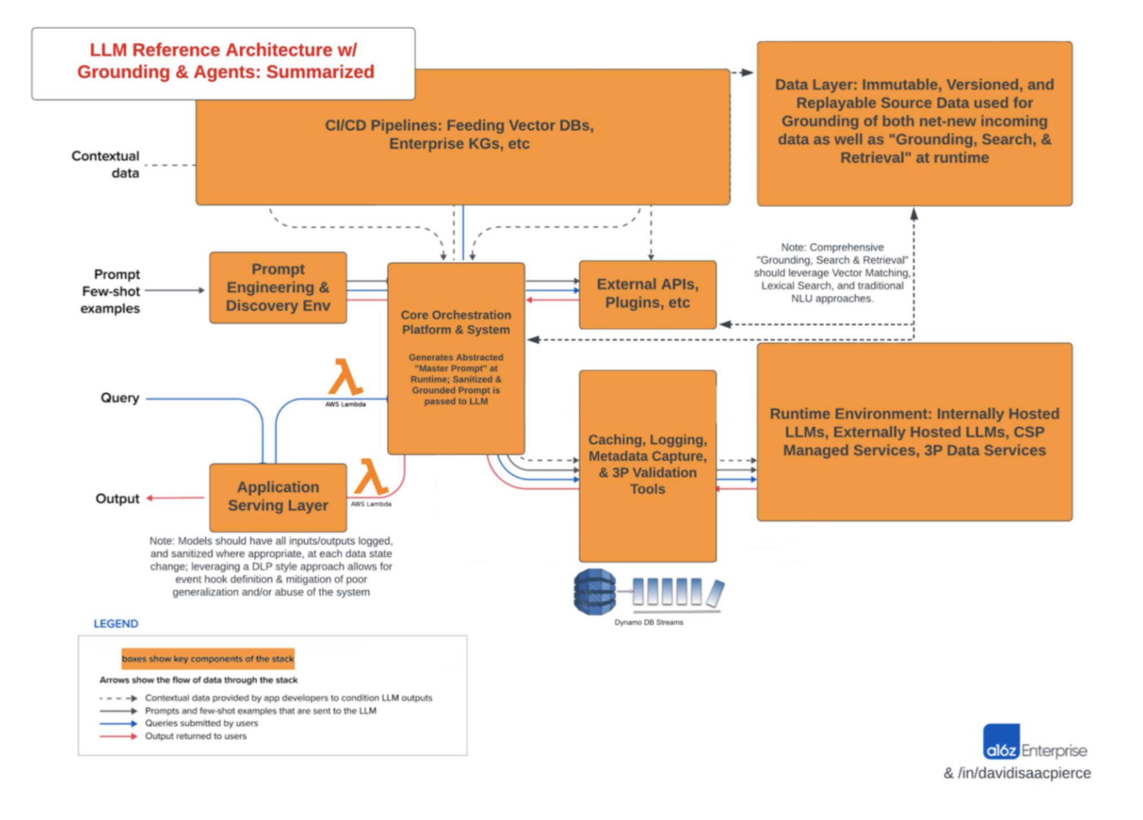


Core Concepts & Key Components
Concepts
Real-Time, Batch, & AI-Driven Orchestration
Downstream Pipelines & Agents
Contextual Grounding & Guardrails
Components
Pre-Processing & Enrichment
Abstraction & Input Sanitization
Monitoring, Validation & Output Sanitization
Notes:
4.1 So how do we start to think about these systems? Initially with data pipelines and your source of truth
click
4.2 Then you can start to think about how you expose your system to users, integrate with other tooling, etc
click
4.3 Finally you can plan for how you abstract your runtime while logging your inputs and outputs.
Whether driving real-time decisions, coordinating the efforts of self-directed agents, or making sure to curate an up-to-date source of truth it turns out these systems are capable of some pretty incredible things, especially when you zoom in
click
4.4 That's where the controls come into play.
click
4.5 without those key components listed on the bottom left, you mind find that your chatbot or autonomous agent went off track.
click

Slide 5
Evolving AI Security Landscape
Threat Vectors
Specialized Tooling
Ubiquitous Access
Myriad Vectors for Exploiting Gen AI Systems via templated, infinitely generatable, and universally transferrable attack strings
(Sub)Domain Spoofing as a means of collecting not only credentials, but user data, and information about underlying model dataset
Supply Chain & Data Poisoning attacks via ubiquitous repos (e.g. PyPI, PySpark, etc) or datasets; hidden within branchless human-inscrutable optimizations
WormGPT et al. were built on old models and suboptimal data; BYO malware is trivial even for non-state actors
Flipper Zero has community modules & firmware; wardriving is old hat, and script-kids have new toys
Post-Quantum Cryptography isn’t magic; trust but verify e.g. DES v2
Quantized Models are running on phones, Colab Notebooks have TPUs, and Open-Source AI is the default
Autonomous Agents and Swarms are emerging as on-demand botnets sans the effort or curation; think burner cellphones
Credential Stuffing & Data Breaches facilitate automation of public user identification, personal account takeover, and professional account spear-phishing
Notes:
especially when it’s actively being attacked. It turns out there's lots of ways to sneak vulnerabilities into your system if you don't have good controls in place. Bad actors and rogue states have tooling that makes it trivial to develop new attacks. Whatsmore the shrinking of these models, availability of compute, and data breaches make it easier than ever to automate.
click

Slide 6
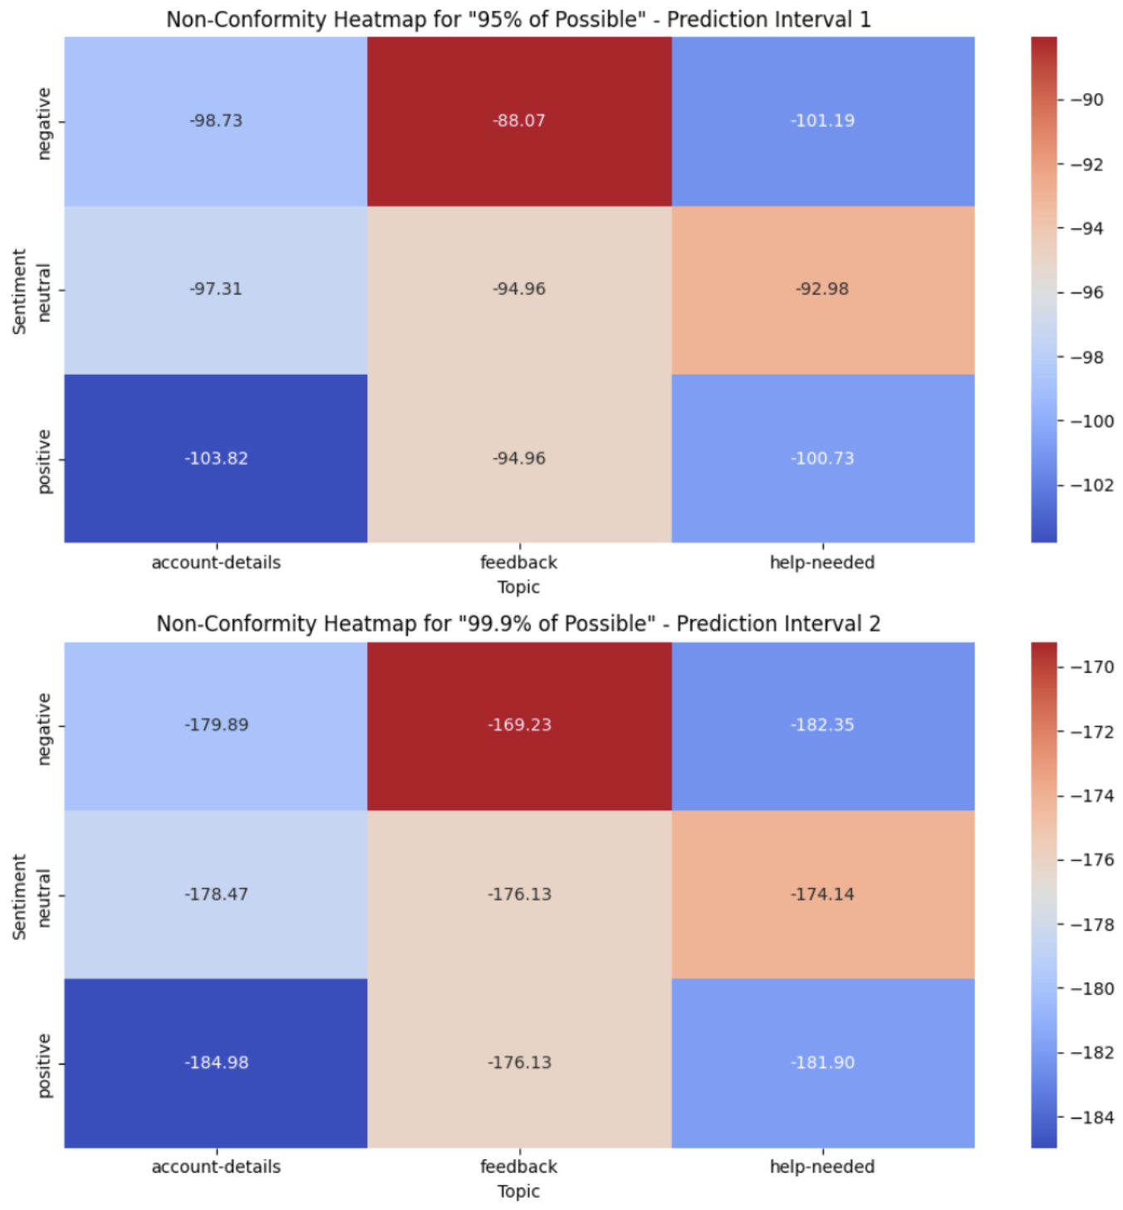
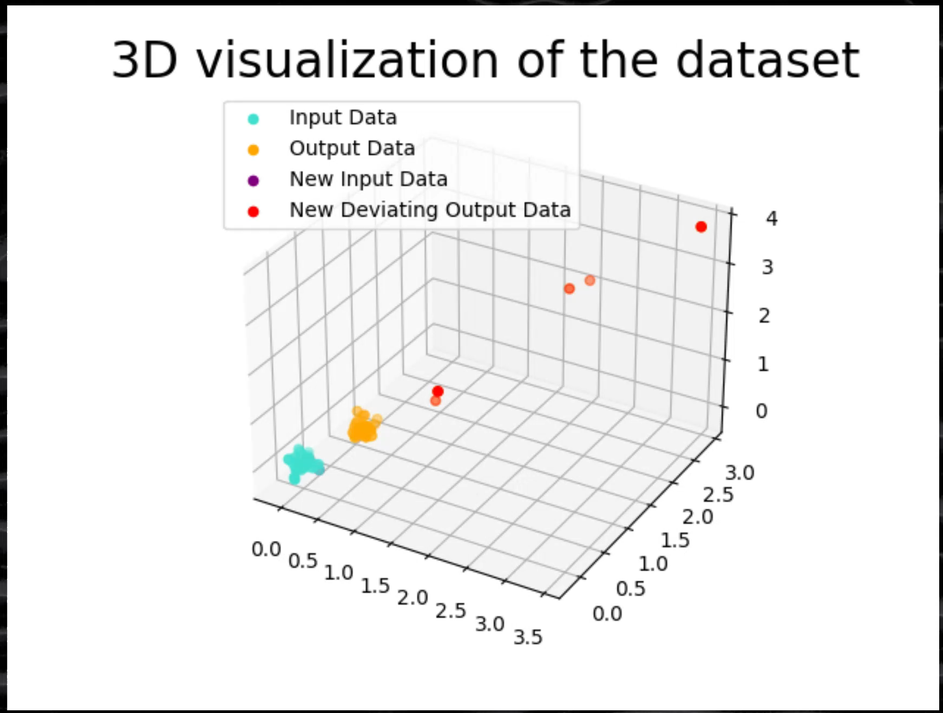
How do you know what your system is doing?
Exponential Growth & Emergent Behaviors
Auto-Regressive Models are bad at planning
Forthcoming Next-Gen Objective-Driven Models
Emergent Behaviors x Bad IAM Policies
Non-Deterministic Systems vs Next-Gen Analytics
Inputs don’t predict Outputs; adjust your priors
Managing Data across states; persist everything
Measure Non-Conformity & Allow for Evolving Schemas
Executive Summary Available
Notes:
That sounds hard right? Nope. LLMs (at least for now) are bad at planning out their day, and we just need to watch what they’re doing. Video
This helps explain the concept in play, but the key really is just making sure models don’t wander into places they’re not built for. Doing that involves 3 things: Better Statistical Methods, Good Data Management Practices, and Evolving Schemas driven by “what good looks like” click Plus you can even use those fancy statistics to forecast behavior

Slide 7
Calculating Exposure by Dimension
Security Posture
Data Sensitivity
Data Licensure
Internal: System Exclusively interacted with by internal hardware, networks, etc
Hybrid: System interacts with 3rd Party Systems, tooling, etc
External: System is designed to interact with public facing systems by design
Public: No add’l risk imposed on system
Internal: Minor add’l risk imposed; may need access controls, etc
Confidential: Major add’l risk imposed; may require add’l validation
Restricted: Existential add’l risk imposed; will require add’l access & validation controls
Zero/1st Party Data: Self-Generated Data else Data Captured via explicit EULA
3rd Party Data: Data Licensed by 3rd Parties to specific integrations and bound by specific terms; should define assumed liability and indemnity for utilization
Public Data: broadly available data utilized in the training and fine-tuning of AI systems that may have existing licensure; else scraped sans terms
Notes:
Cool right? Yep, but still sounds like some use cases might need that much rigor. Absolutely, which is why you need a framework for efficiently managing risk across the 3 dimensions you see on screen.
How you position your system, how sensitive the data is, and how you acquired that data all help determine what controls you need.

Slide 8
Solving for Residual Risk
Access Constraints
SSO/VPN
MFA (Authenticator, SMS, etc)
Validation Controls
Input Validation e.g. Lambda, Elastic Cache
Output Validation e.g. Lambda, S3 (for baseline)
Statistical Monitoring
Clustering & Vectorization e.g. Lambda, DynamoDB
Forecasting Drift & Alerts e.g. EC2, S3, SNS
Rules-based Monitoring
Conditional Guardrails e.g. NeMo by Nvidia
Post-Processing e.g. SteerLM by Nvidia
Risk-based Capabilities & Controls | Internal System | Hybrid System | External System
Public Data | No Access or Validation Constraints | No Access Constraints; Requires Input Validation | No Access Constraints; Requires Input/Output Validation & Active Monitoring
Internal Data | SSO/VPN Access Constraints; No Mandatory Validation | SSO/VPN Access Constraints; Input Validation | SSO/VPN Access Constraints; Input & Output Validation w/ Active Monitoring
Confidential | SSO/VPN/MFA Access Constraints; Input Validation | SSO/VPN/MFA Access Constraints; Input & Output Validation | SSO/VPN/MFA Access Constraints; Input & Output Validation w/ Active Monitoring
Restricted | SSO/VPN/MFA Access Constraints; Input & Output Validation | SSO/VPN/MFA Access Constraints; Input & Output Validation w/ Active Monitoring | SSO/VPN/MFA Access Constraints; Input & Output Validation w/ Active Monitoring + Conditional Guardrails
Notes:
In practice that means being able to quickly decide what requirements exist for software teams, or how you might need to beef up vendor solutions.
For example, Simple Access Management via might be enough for an internally facing chatbot. But you might need both statistical monitoring and business rules for complex systems.

Slide 9
Mitigating Liability
Leadership & Legal Review
Business Acceptance of Risk
Legal Validation of Indemnity
Legal Assessment by SMEs
Risk-based Capabilities & Controls | Zero of 1st Party Data | 3rd Party Data | Public Data
Public Data | Business Acceptance of Risk; Legal Assessment by SMEs | Legal Assessment by SMEs; Legal Validation of Indemnity | No Access Constraints; Requires Input/Output Validation & Active Monitoring
Internal Data | Business Acceptance of Risk | Legal Validation of Indemnity; Business Acceptance of Risk | Business Acceptance of Risk; Legal Assessment by SMEs
Confidential | Business Acceptance of Risk; Legal Assessment by SMEs | Business Acceptance of Risk; Legal Validation of Indemnity; Legal Assessment by SMEs | Business Acceptance of Risk; Legal Assessment by SMEs
Restricted | Business Acceptance of Risk; Legal Assessment by SMEs | Business Acceptance of Risk; Legal Validation of Indemnity; Legal Assessment by SMEs | Business Acceptance of Risk; Legal Assessment by SMEs
Notes:
The same is true of data licensure. Data you own makes sense, but still needs business acceptance for sensitive things. 3rd party data might describe the legal liability and indemnity on offer, but make sure you have Legal validate that.
Public data is harder since there are still ongoing legal challenges to what constitutes fair use; better to just double check with counsel

Slide 10
Planning for the Future
Minimum Requirements
Paradigm Shifts
Best Practices
Manage your Risk Appropriately; an externally facing system needs more active monitoring and controls
Secure Sensitive Systems; use the Gen AI Hardening Checklist attached in the appendix alongside open-source benchmarks
Build Purple Teams; matrix the efforts of your red/blue teams to also include your application and model development resources
Myriad In-The-Wild Exploits for LLMs (Data Extraction, Modified API Calls, etc); includes decoding previously embedded data within a DB
Working Memory Graphs & Efficient Traversal via differently embedded structures utilizing eventual consistency affecting Operational Analytics e.g. various granularity
Compromised applications utilizing a federated non-tokenized latent space and shared models creating hidden human inscrutable application logs
Instrumented CI/CD Pipelines with Bill-of-Materials & Dynamic Policies via OPA/Rego
Documented Per Release “Scope of Change” allows for Remediation, Repackaging & Ongoing Monitoring
Active curation & utilization of known good or bad embedding spaces; use of specific models for limited corpus
Use of LLMs in documenting per pipeline policies & requirements via curation of Enterprise Knowledge Graphs
Notes:
That gets us up to now, but we should also be anticipating the problems of tomorrow. click Working Memory Graphs are going to mean that even today’s LLMs can more easily navigate and accomplish their tasks Also federated embedding models make it easy build hidden messages into logs you can see but won’t need words; that’s a human requirement click
Good news is that best practices mitigate those types of threats, and a little bit of planning goes a long way. So curate known good examples of application logs, build a knowledge graph, and carry on.

Slide 11
Q&A
Topics of Interest: What about X, Y, or Z? How do we plan for an AGI? Have you considered 1, 2, or 3?
Notes:
There’s other aspects to Observability beyond security; namely Governance and Performance Monitoring Happy to clarify any of the security stuff, frame the other aspects of observability, else talk about other topics.

Slide 12
Appendix
Add’l Resources & Links

Slide 13
Gen AI Hardening Checklist
Key Exposures & Mitigations for Sensitive or External LLM Systems

Slide 14
Gen AI System Vulnerabilities
Optimization-Free Attacks
Key Exposure: Brand Reputation Damage & Performance Degradation
Dependency: Requires specific API fields; no pre-processing
Pre-Processed Attacks
Key Exposure: Data Loss via Exploitation of Distributed Systems making API calls
Dependency: Requires localized target; universal & transferable
System Context Extraction
Key Exposure: Documentation & Distribution of System Vulnerabilities; Non-Compliance with AI Governance Standards
Dependency: Requires API Access over time; ‘blind SQL injection’ for LLMs
Model Context Extraction
Key Exposure: Documentation & Distribution of Model-Specific Vulnerabilities
Dependency: API Access for context window; VectorDB Access for embeddings
Training Data Extraction
Key Exposure: Legal Liability from Data Licensure Breaches; Non-Compliance with AI Governance Standards
Dependency: Requires API Access over time; ‘rules’ defeated via prior system and model context extraction paired with optimized attacks
Supply Chain & Data Poisoning
Key Exposure: Brand Reputation Damage & Performance Degradation; Non-Compliance with AI Governance Standards, especially for “high-risk systems”
Dependency: Target use of compromised data & models; integration of those vulnerabilities with CI/CD systems
Model-Specific Vulnerabilities
Key Exposure: Documentation & Distribution of System Vulnerabilities; Brand Reputation Damage & Performance Degradation
Dependency: Lack of Active Assessment of Sensitive or External Systems

Slide 15
Optimization-Free Attacks
Dependency: Requires specific API fields; no pre-processing
Key Exposure: Brand Reputation Damage & Performance Degradation
Takeaway: Mitigate low-complexity priming attacks via evaluation of input/output embeddings against moving windows of time, as well as limits on what data is available via API (e.g. Next-Token Probabilities aka Logits); also mitigates DDoS attacks and indicates instances of poor generalization

Slide 16
Pre-Processed Attacks
Dependency: Requires localized target; universal & transferable
Key Exposure: Data Loss via Exploitation of Distributed Systems
Takeaway: Defeat pre-processed optimization attacks by pre-defining unwanted behaviors, actively monitoring for similar behavior, as well as utilizing windowed evaluation of input/output embeddings against application-specific baselines

Slide 17
System Context Extraction
Dependency: Requires API Access over time; ‘time-based blind SQL injection’ but for LLMs
Key Exposure: Documentation & Distribution of System Vulnerabilities, Non-Compliance with AI Governance Standards, etc
Takeaway: Mitigate retrieval of information about the system and application controls from Time-Based Blind Injection Attacks via Application-Specific Firewalls and Error Handling Best-Practices; augment detection for sensitive systems by evaluating conformity of inputs/outputs against pre-embedded attack strings, and flagging long-running sessions for review

Slide 18
Model Context Extraction
Dependency: API Access for context window; VectorDB Access for embeddings
Key Exposure: Documentation & Distribution of System Vulnerabilities
Takeaway: Reduce the risk from discoverable rules, extractable context (e.g. persistent attached document-based systems context), etc via pre-defined rules; prevent decodable embeddings (e.g. additional underlying data via VectorDB & Backups) by adding appropriate levels of noise or using customized embedding models for sensitive data.

Slide 19
Training Data Extraction
Dependency: Requires API Access over time; ‘rules’ defeated via prior system and model context extraction paired with optimized attacks
Key Exposure: Legal Liability from Data Licensure Breaches, Non-Compliance with AI Governance Standards, etc
Takeaway: Prevent disclosure of underlying data while mitigating membership or attribute inference attacks with pre-defined context rules (e.g. “no repetition”), whitelisting & monitoring of allowed topics, as well as DLP paired with active statistical monitoring via pre/post-processing of inputs/outputs
i.e. Data Extraction Attacks build upon pre-discovered rules/context and pre-optimized attacks

Slide 20
Supply Chain & Data Poisoning
Dependency: Target use of compromised data & models; integration of those vulnerabilities with CI/CD systems
Key Exposure: Reputation Damage & Performance Degradation, Non-Compliance with AI Governance Standards, especially “high-risk systems”
Takeaway: Mitigate Supply Chain & Data Poisoning attacks via use of Open-Source Foundation Models and Open-Source Data wherein Data Provenance/Lineage can be established, versions can be hashed, etc; thereafter affect access and version control of fine-tuning data, contextual data (i.e. augmented generation), etc.

Slide 21
Model Specific Vulnerabilities
Dependency: Lack of Active Assessment of Sensitive or External Systems
Key Exposure: Documentation & Distribution of System Vulnerabilities; Brand Reputation Damage & Performance Degradation
Takeaway: Utilize a Defense in Depth approach (e.g. Purple Teaming), especially for Auto Regressive Models, while staying up to date on the latest attack & defense paradigms; utilize open-source resources, contribute to the community, etc.

Slide 22
Visualized Attacks
And code samples where appropriate

Slide 23
Pre-Processed Attacks
Summary: Auto-Regressive Models were built for text completion; they can be tricked into thinking they already said yes, and then comply with the target instruction (e.g. use specific arguments in an API call)

